Slide 1
CREA Executive Committee Meeting March 12, 2021 Scott Bolton, Senior Vice President, Transmission Development

Slide 2
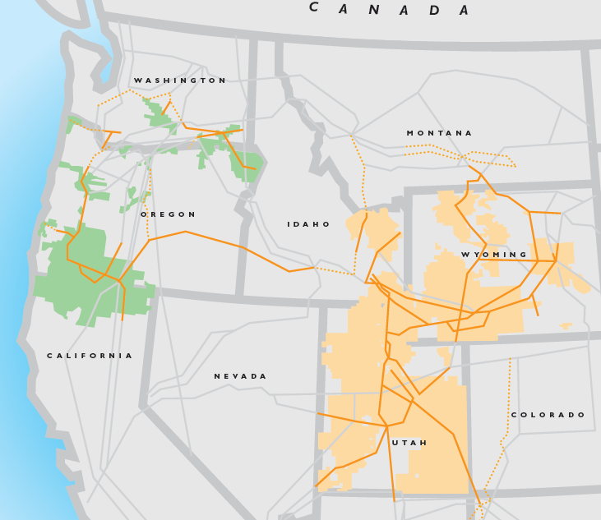
PacifiCorp System and Service Area
Total customers: 2,031,567
Transmission line miles: 16,822
Poles: 162,005
Substations: 360
MSP allocation factors (transmission and most generation plants) by state:
CA: 1.6%
OR: 26.0%
WA: 7.9%
UT: 44.0%
ID: 5.9%
WY: 14.6%

Slide 3
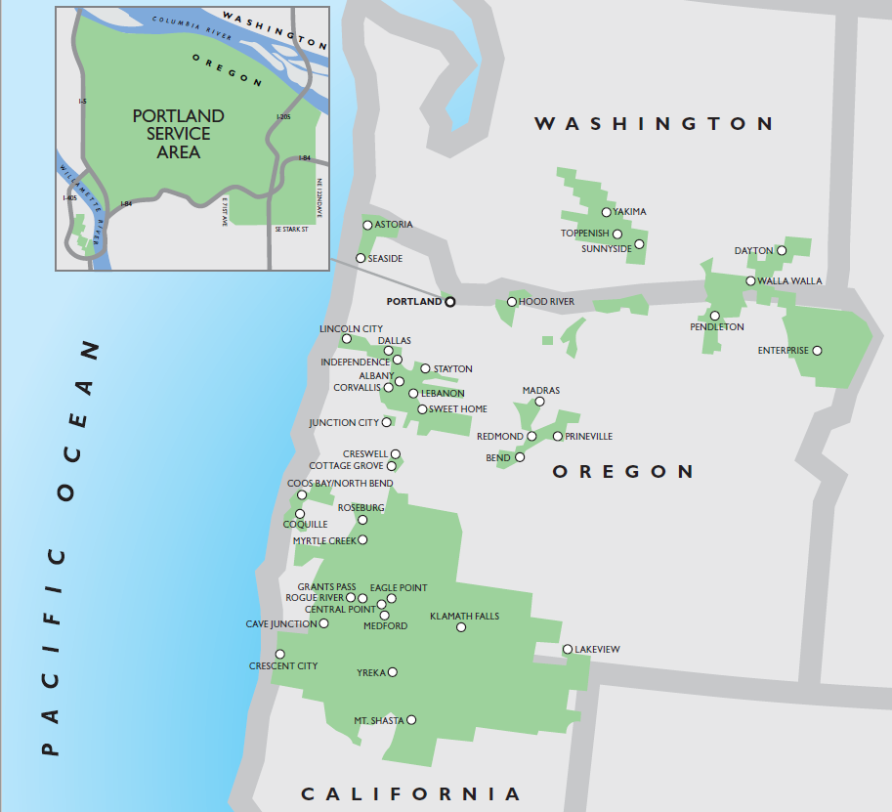
Pacific Power Service Territory
627,282 Oregon customers
Retail Direct Access for Large Loads
Energy Trust of Oregon – 3rd Party DSM Delivery
SB 1547 (2016) – Requires coal out of rates by 2030; 50% RPS by 2040

Slide 4
Qualifying Facilities
Small Scale Renewable Projects (Under 20 megawatts) as of February 2021
 | Oregon Projects |  |  | System-wide Projects (Including Oregon)
 | QF | Non-QF | PacifiCorp-Owned | QF | Non-QF | PacifiCorp-Owned
Capacity (Megawatts) | 386.1 | 7.0 | 160.6 | 595.0 | 99.0 | 402.0
Number of Projects | 70 | 2 | 20 | 126 | 8 | 61
Annual Cost (QF Only) | ~$65 m |  |  | ~ $ 88 m
 | Note: these values do not differentiate for REC ownership or REC disposition
 | QF data includes projects in operation and under contract but not yet in operation. Annual cost estimate is based on 2020 generation (QFs in operation) and estimated projections (QFs under contract) for Oregon small renewables

Slide 5
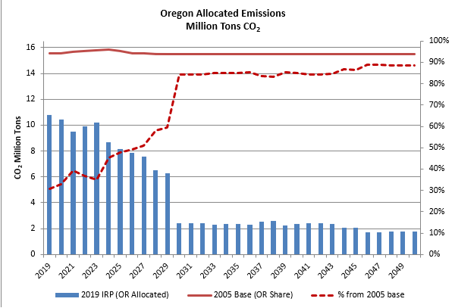
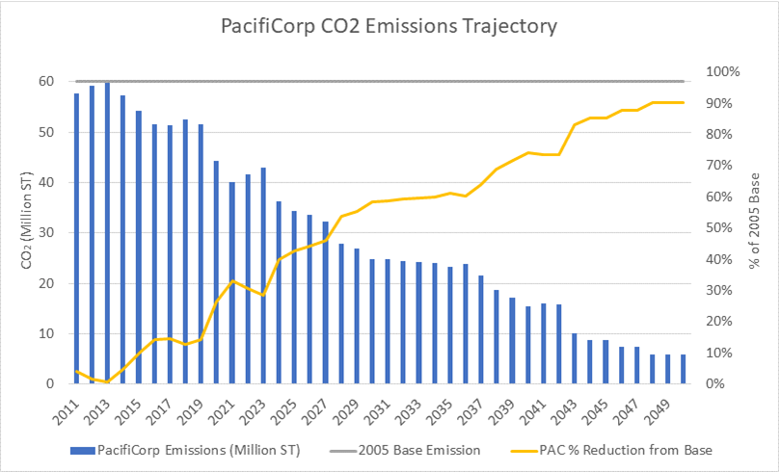
2019 IRP Projected Emissions

Slide 6
Thank you!

