Slide 1
Community Choice Aggregation
A Local Government Tool to
Boost the Local Economy, Increase Resiliency and Green the Grid

Slide 2
The Evolution of the Grid
The full stack utility monopoly of 100 years ago made sense
One Size Fits All: Safe, Reliable and Affordable Energy for Everyone
Mission Accomplished – But times have changed
Technology is enabling distributed energy resources
Communities want, and can, have choice

Slide 3
Enter Community Choice Aggregation or CCA
A Public Entity that allows community participation in energy choices: City, County or Regional
Not Anti-Utility but Pro-Community while allowing the Utilities to continue to do what they do best
Not full Municipalization - also called Muni-Lite
Transmission and Distribution remain with the Utility
The utility continues to provide the same services such as Outage Support, Billing, Grid Maintenance and Capital Improvements

Slide 4
Benefits
Local Control over Energy Choices – Which is simply not possible with current regulatory environment
Economic Development – Local energy production, local labor content and other community specific needs
Equity – Rate setting, other programs
Resilience – Humboldt Solar+Storage project

Slide 8
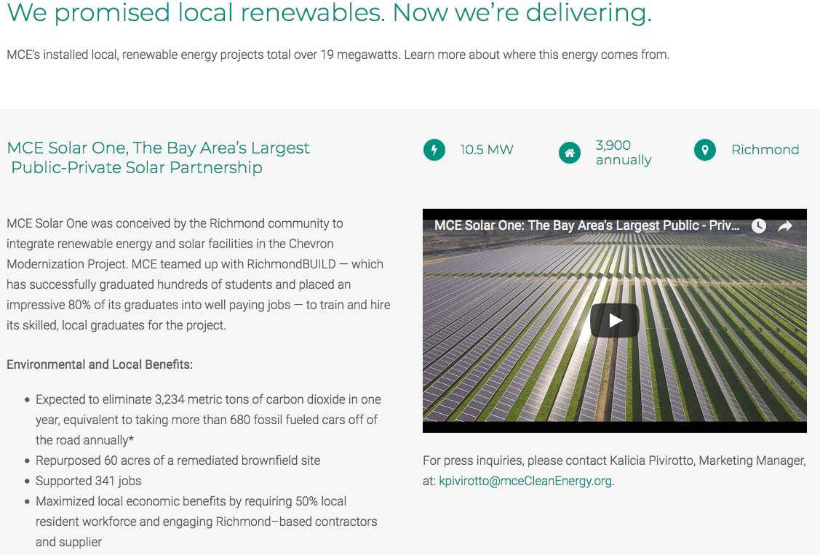
Marin Clean Energy – 10.5MW solar project

Slide 10
Key tenants of an Oregon CCA solution
The Energy Trust of Oregon remains a key partner
Conformance to the Renewable Portfolio Standard (RPS)
COUs are outside this effort – but could see opportunity
The Oregon Public Utility Commission’s role remains vital
Key questions to be answered include:
Exit Fees aka Stranded Asset Cost
Provider of Last Resort
Resource Adequacy
Remaining Utility Ratepayers held harmless

Slide 11
Next Steps – Making it a Reality
The Ask: Local community Resolution or Letter of Support to explore the concept
Enabling Legislation
Local support will be critical
Continued stakeholder input
Public Utility Commission Rulemaking
Once in place it will be up to local communities to participate

Slide 12
Thank You
www.leanenergyoregon.org
www.leanenergyus.org
Alan Hickenbottom
alan.hickenbottom@gmail.com
503-703-0602

