Slide 1
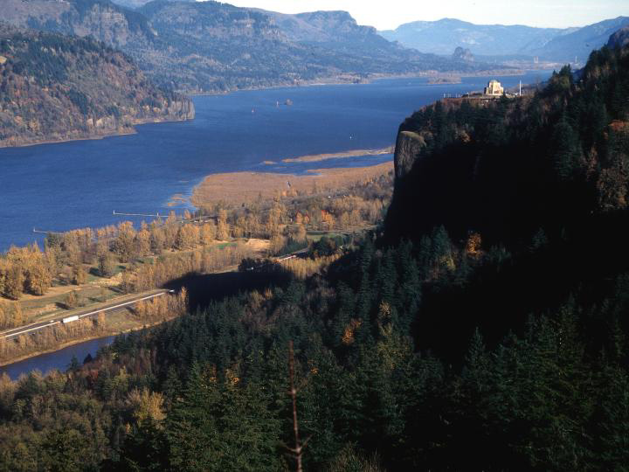
Title
B O N N E V I L E P O W E R A D M I N I S T R A T I O N
Bonneville Power Administration
Update
Sub Title
Julie Peacock, BPA

Slide 2
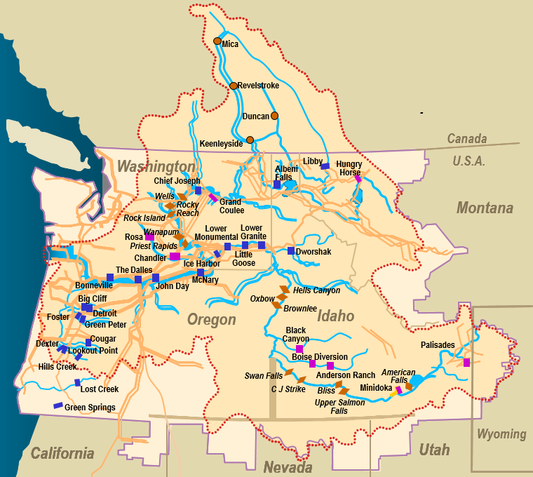
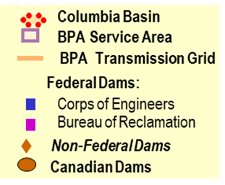

Introduction to Bonneville
BPA markets power from 31 Federal hydro plants, the Columbia Generating Station Nuclear Plant, and several small non-Federal power plants
BPA owns no power generators.
About 80% of the power BPA sells is hydroelectric.
BPA accounts for about 28% of the electric power consumed within the PNW and about 30 percent of power consumed in Oregon.
BPA recovers all costs from selling power and transmission services.
BPA, with USCOE & USBR, invests $250 - $300 million per year in Fish & Wildlife programs across the Columbia River basin
Federal Columbia River Power System Columbia River Basin & BPA Service Area

Slide 3
BPA’s Business Model: Providing Public Benefits
BPA must balance its responsibilities to . . .
Assure adequate, economical, efficient, reliable power supply.
Recover costs through rates. BPA is a self-sustaining non-profit agency.
Ensure transmission access with a high degree of safety and reliability.
Ensure public preference and regional preference.
Fulfill environmental and social responsibilities:
  Mitigate impacts, protect and enhance fish & wildlife populations affected by the federal hydropower system.
  Provide regional leadership in conservation and renewable resource development.
Preserve and balance economic and environmental benefits of the FCRPS.

Slide 4
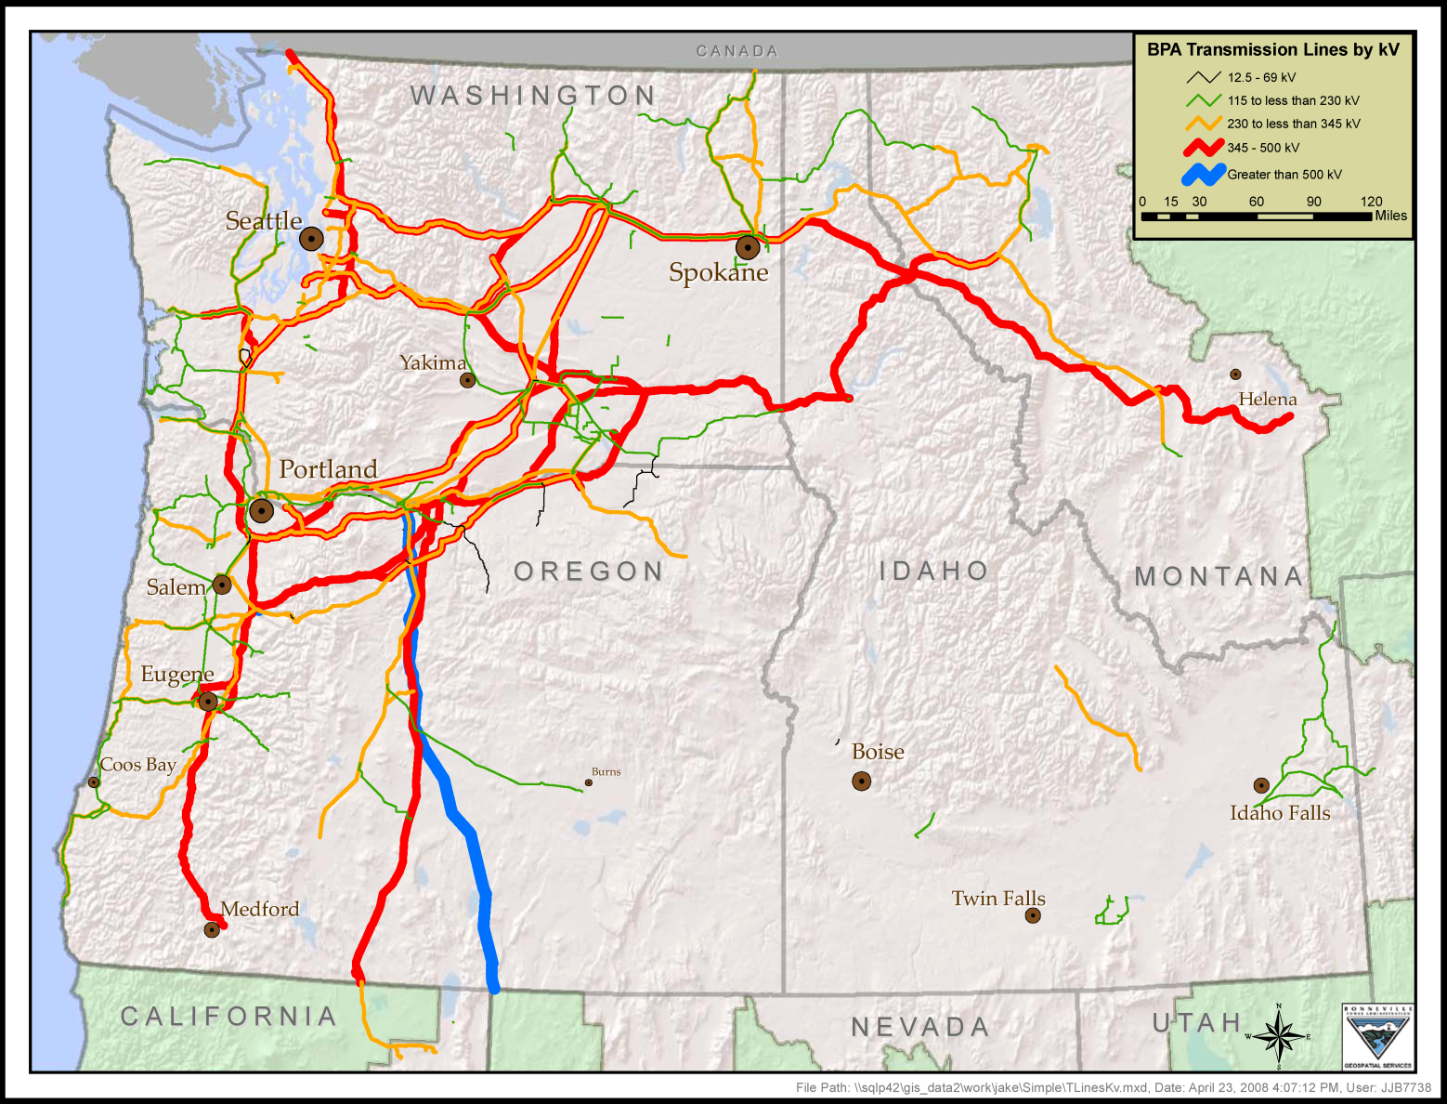
BPA’s Transmission System
Transmission System
Operating voltage Circuit miles
1,000 kV……………………........... 264*
500 kV ………………......... 4,735
345 kV ………………………. 570
287 kV ………………………. 229
230 kV …………………….. 5,324
161 kV ………………………. 119
138 kV ………………………… 50
115 kV …………………….. 3,556
below 115 kV ………………...368
Total 15,215
*BPA’s portion of the PNW/PSW direct-current intertie. The total length of this line from The Dalles, OR to Los Angeles, CA is 846 miles.
4

Slide 5
BPA’s high-voltage transmission system
BPA owns and operates about 75% of the Pacific Northwest’s high voltage electrical transmission system.
BPA’s system includes more than 15,000 miles of transmission line and 259 substations.
The Federal Columbia River Transmission System spans across 300,000 square miles in Oregon, Washington, Idaho, Montana and sections of Wyoming, Nevada, Utah and California.
The system enables a peak loading of about 30,000 megawatts and generates more than $700 million a year in revenues from transmission services.
BPA’s Transmission Business Line operates under an Open Access Transmission Tariff based on FERC’s pro forma tariff as a non-jurisdictional entity.

Slide 6
BPA’s Strategic Objectives
Strengthen Financial Health
Modernize Assets and System Operations
Provide competitive power products and services
Meet transmission customer needs efficiently and responsively
Value people and deliver results

Slide 7
Boardman to Hemingway
Newly signed term sheet that updates BPA’s role with B2H
Allows BPA to acquire transmission service through Idaho Power’s OATT B2H rather than becoming a partial owner
The draft term sheet removes BPA’s role as a permitting partner and future partial owner of B2H
PacifiCorp transfers assets to IPC so BPA’s Southeast Idaho Load Service loads would be in IPC’s transmission system

Slide 8
Wildfire Mitigation and Public Safety Power Shut Offs
Bonneville has a Wildfire Mitigation Plan, which was most recently updated in April 2021
In the plan, we outline our Public Safety Power Shut-off policy, which was utilized during the 2021 Summer Season
Conditions identified for a PSPS include: Red Flag Warning, winds of 60 mph or more, a risk-assessment of the transmission line, and fuel type/loading
Transmission has been working to mitigate the lines that were identified as high-risk across BPA’s system
A PSPS does not always mean power disruption

Slide 9
Emerging Regional Markets
CAISO EIM: BPA moved back its ‘go-live’ date with EIM by two months to allow for additional testing
Western Power Pool Resource Adequacy: BPA has been actively engaged throughout the process, currently in Phase 3A
CAISO EDAM and SPP Markets+: BPA is engaged in the discussions at CAISO and SPP around the development of day-ahead markets

Slide 10
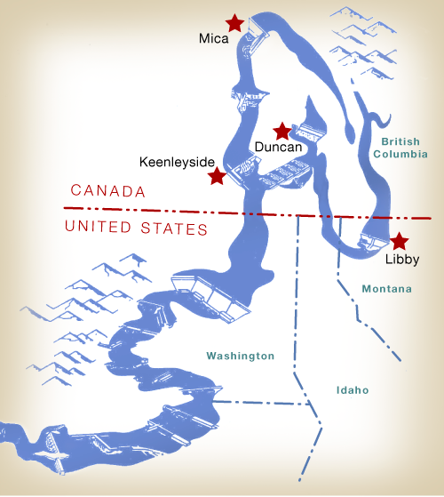
Columbia River Treaty 2014/2024 Review
Columbia River
Treaty
The year 2024 is a significant date for BPA and the Columbia River Treaty. It marks the end of 60 years of pre-paid flood control space from Canada.
In addition, either Canada or the United States can terminate most of the provisions of the Treaty any time on or after Sep. 16, 2024, with a minimum 10 years’ written advance notice (hence, the reference to 2014).
Due to the importance of these issues, the U.S. Army Corps of Engineers and BPA, the agencies responsible for implementing the Treaty for the United States on behalf of the U.S. Entity, conducted a multi-year effort to study these post-2024 Treaty issues.
The U.S. entity put forward its recommendation in December 2013. The U.S. and Canada began negotiations in 2018. The eleventh round of negotiations occurred in December.

Slide 11
Contact
Julie Peacock
Intergovernmental Affairs, Oregon Liaison
jxpeacockwilliamson@bpa.gov
971-801-5986

